Slide 1
Data Science
Fatima Yousaf
Lecturer,
Department of Computer Science
Notes:
HY, I AM FATIMA YOUSAF. Today am here to tell what, why and how of data science. By the end of my lecture, you will be able to know how data science is being used around you and how you can use data.

Slide 2
Relationship in AI, ML and DL
Machine Learning:
SVM, Tree Algorithms, Nearest neighbors, bagging, boosting, Deep Learning
Artificial Intelligence:
Search Algorithms, Rule Based Systems, Statistical Inference, Machine Learning
Deep Learning:
FCNs, CNNs, RNNs, Transformers, Autoencoders, GANs

Slide 3
Artificial Intelligence
Machine Learning
Deep Learning
Artificial Intelligence is the branch of computer science concerned with development of methods that allow computers to learn without explicit programming.
Machine Learning is a branch of AI, which focuses on methods, that can learn from examples and experience instead of relying on hard-coded rules and make predictions on new data.
Subfield of Machine Learning that focuses on Neural Networks (Inspired from Biological neurons) to develop learning models.

Slide 4
Data Science
It's a set of methodologies for taking in thousands of forms of data that are available to us today, and using them to draw meaningful conclusions.

Slide 5
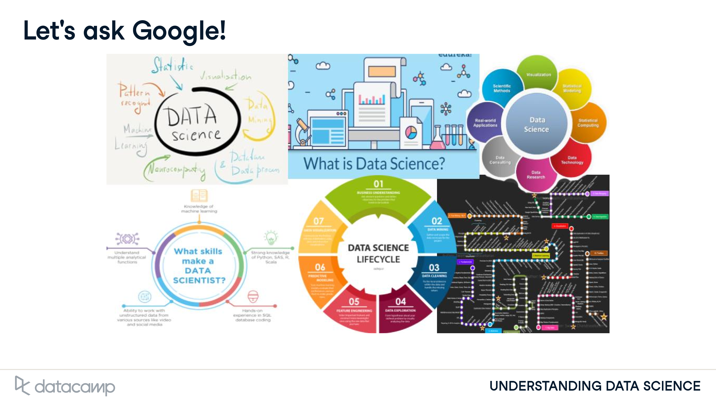
Notes:
If we Google "What is data science?", we'll see a huge amount of confusing information.

Slide 6
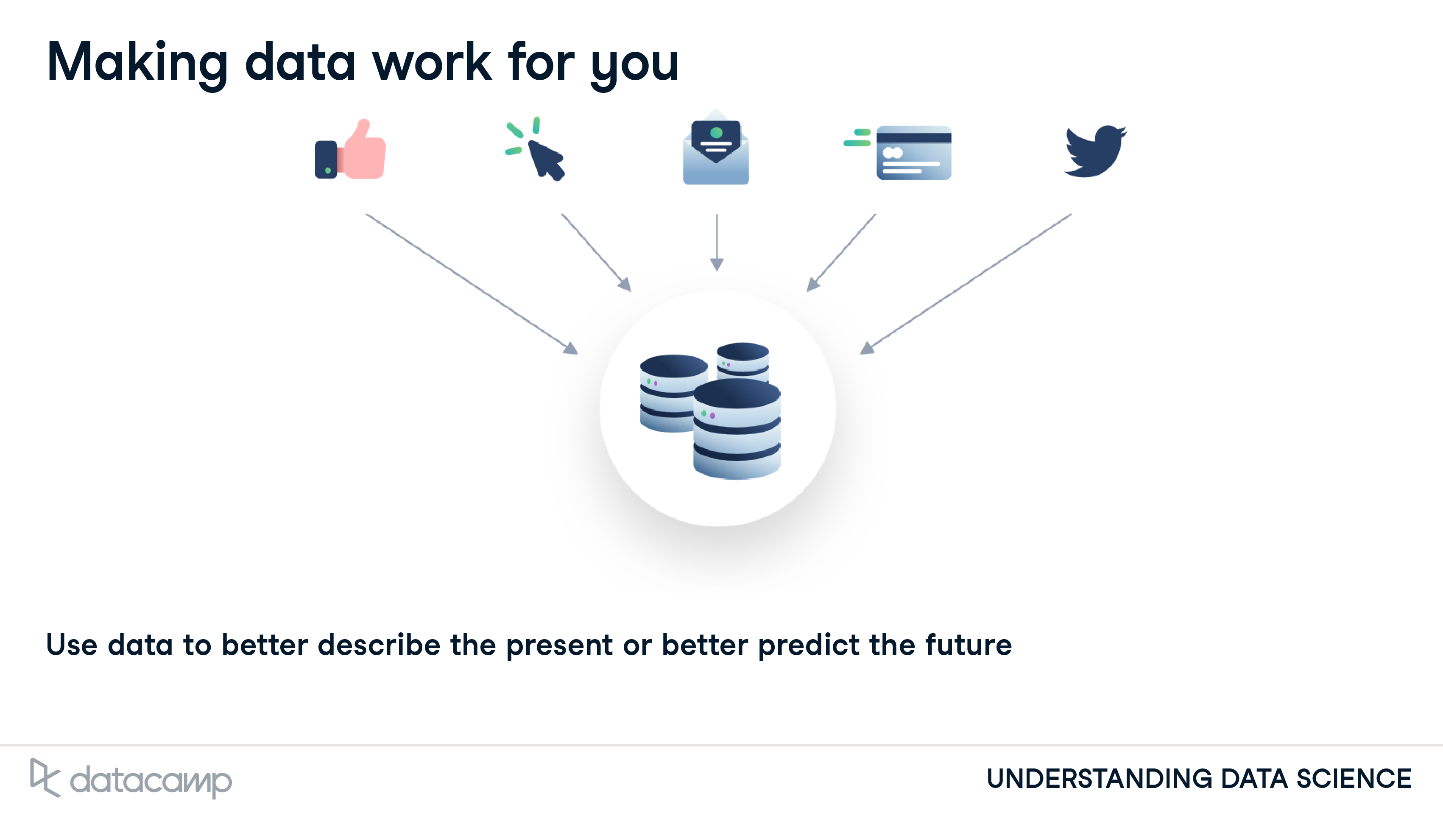
Notes:
But data science is actually simple. It's a set of methodologies for taking in thousands of forms of data that are available to us today, and using them to draw meaningful conclusions. Data is being collected all around us. Every like, click, email, credit card swipe, or tweet is a new piece of data that can be used to better describe the present or predict the future.

Slide 7
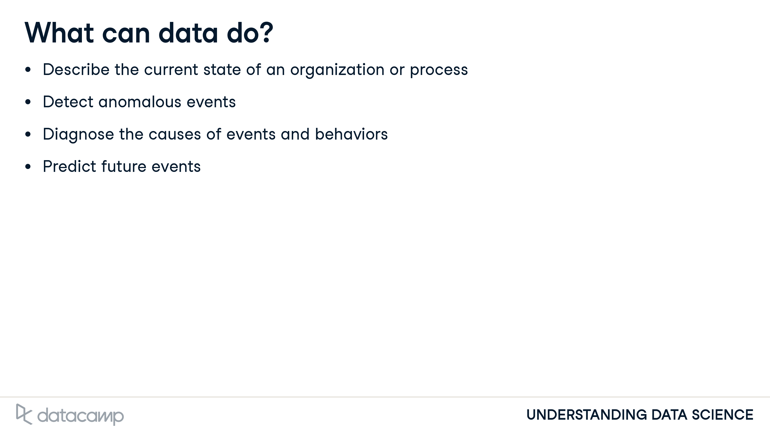
Notes:
So what can data do? Data can describe our current state, like our energy consumption. This can be accomplished with dashboards or alerts, simplifying time-intensive reporting processes. It can help detect anomalous events, such as fraudulent purchases. If we have data on what has happened previously, we can increase efficiency by automatically detecting a new event that is unexpected or abnormal. Data can also diagnose the causes of observed events and behaviors, for instance your activity on Spotify or Netflix. Rather than determining correlations between small numbers of events, data science techniques help us understand complex systems with many possible causes. Finally, data can predict future events, such as forecasting population size. We can use techniques to take various causes into account and predict potential outcomes. Further, we can evaluate the probability of our prediction mathematically to clarify our level of uncertainty.

Slide 8
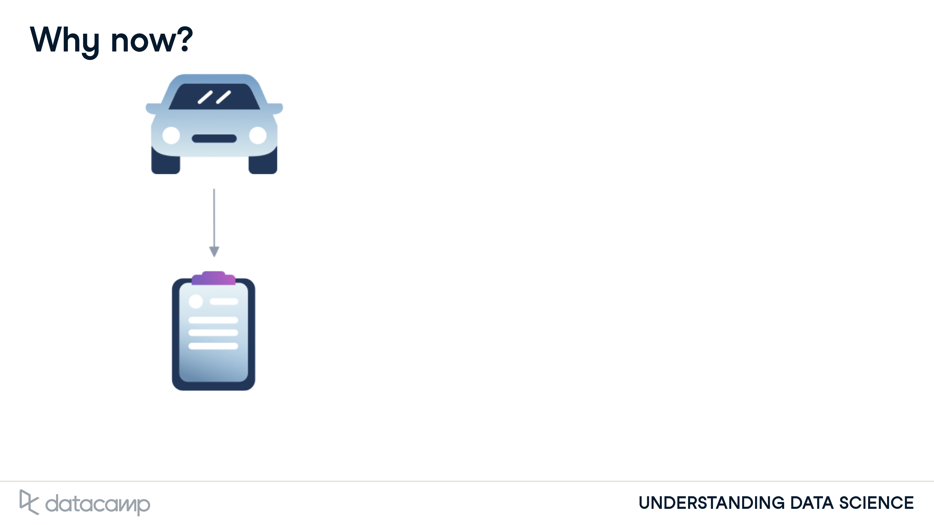
Notes:
So now we know what data science is. The next question is why is it so popular? The answer is pretty obvious: we're collecting more data than ever before. Suppose that you visit a car dealership and fill out some information.

Slide 9
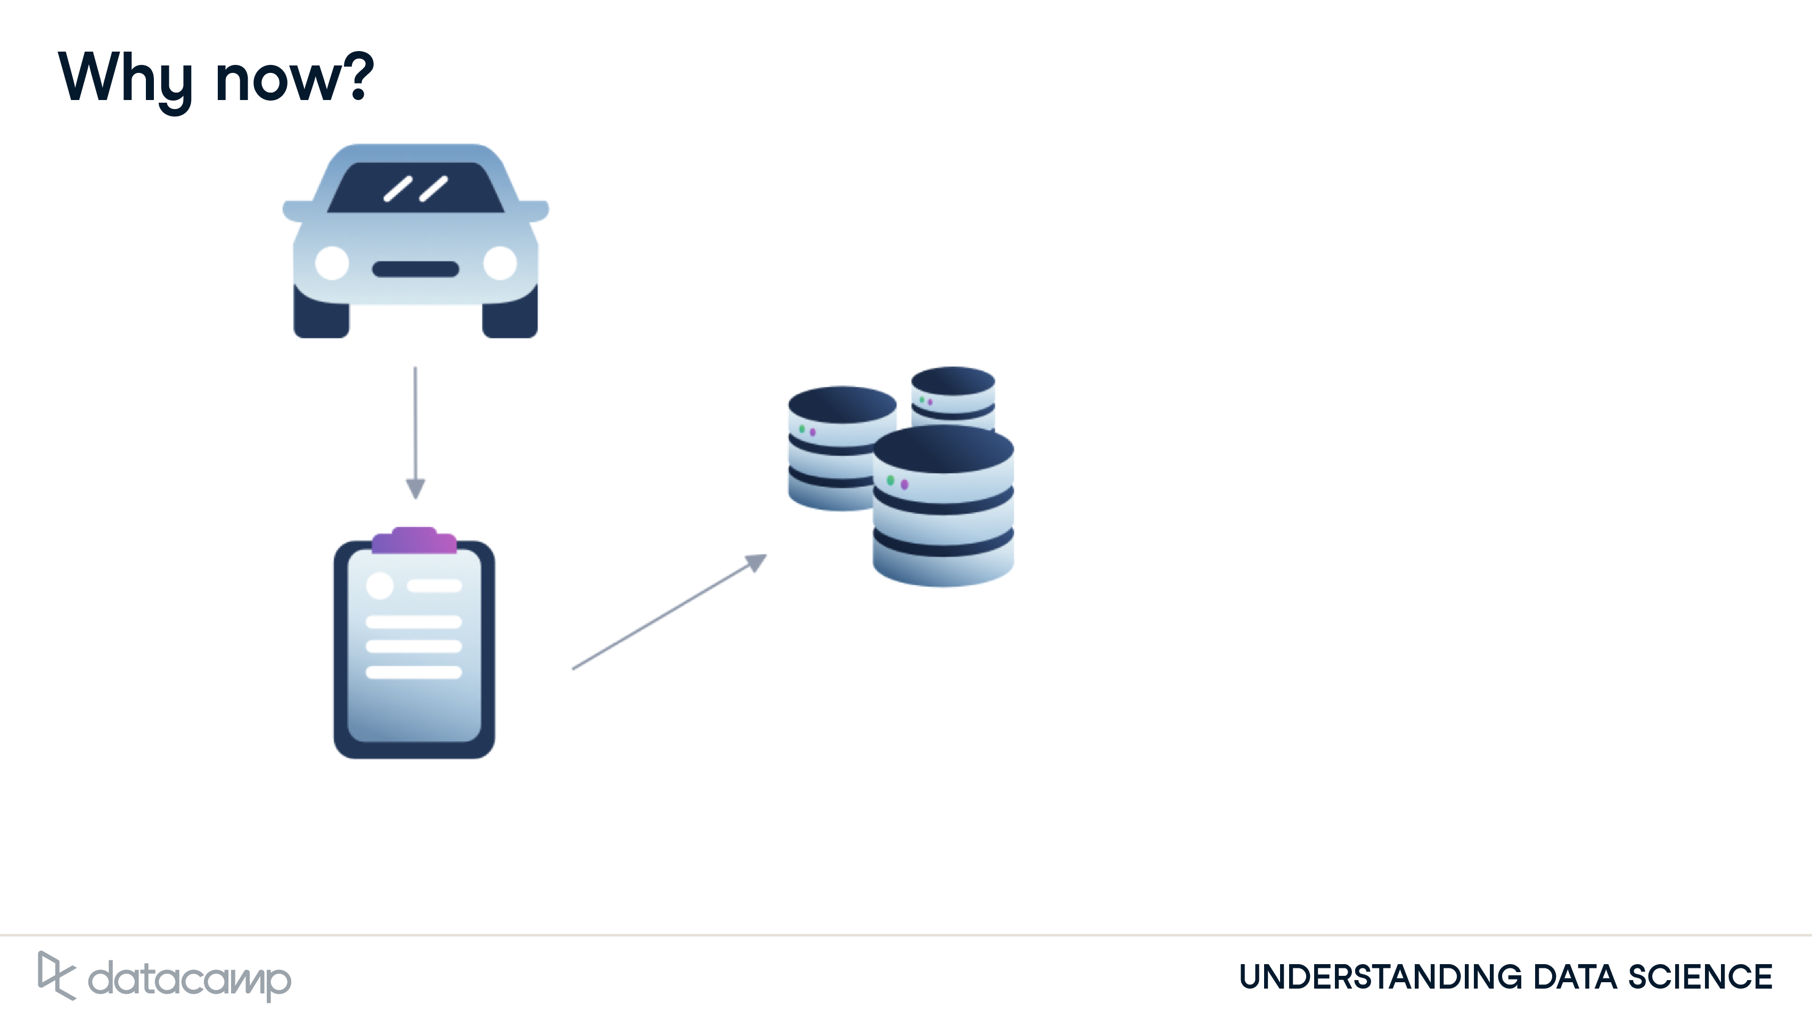
Notes:
All of that data is automatically entered into a computer, and combined with the data from hundreds of dealerships into one big database.

Slide 10
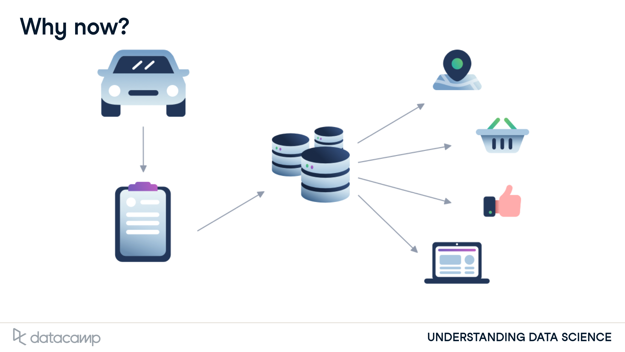
Notes:
Once we have that data, it's easy to use the email address that you provided when you bought that car to tie your car purchase data with your data from social media or web browsing. Suddenly, we have a very complete picture about everyone who purchased a car in the last year: their ages, their likes and dislikes, their families, their friends. This additional data can be used to predict what price you can pay for your car, and what other purchases you're likely to make, or how best to sell you insurance for that new car. Data is everywhere, and it's incredibly valuable information for businesses, organizations, and governments.

Slide 11
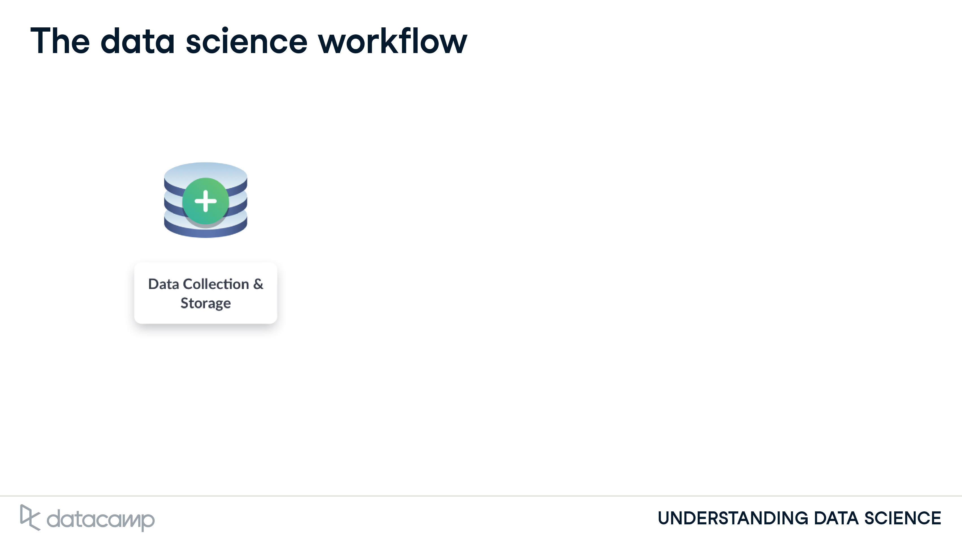
Notes:
So, how do we start to use data? In data science, we generally have four steps to any project. First, we collect data from many sources, such as surveys, web traffic results, geo-tagged social media posts, and financial transactions. Once collected, we store that data in a safe and accessible way.

Slide 12
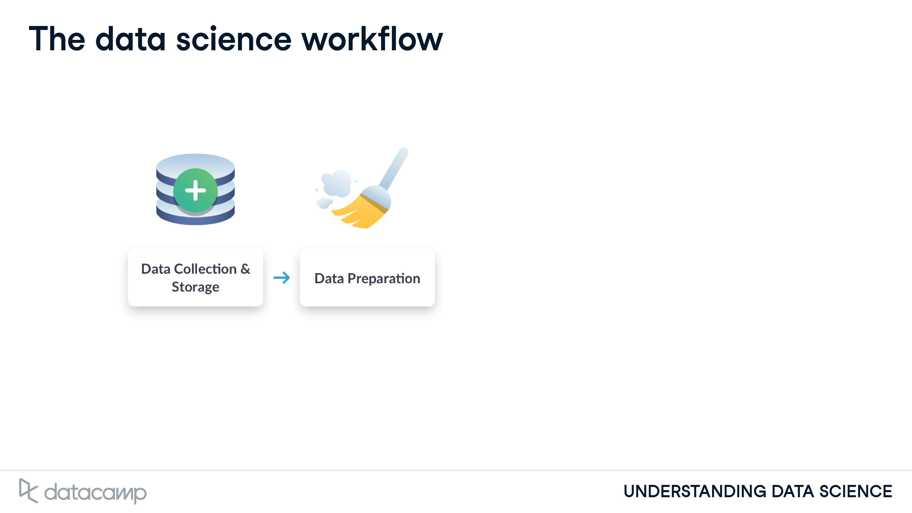
Notes:
At this point, data is in its raw form, so the next step is to prepare data. This includes "cleaning data", for instance finding missing or duplicate values, and converting data into a more organized format.

Slide 13
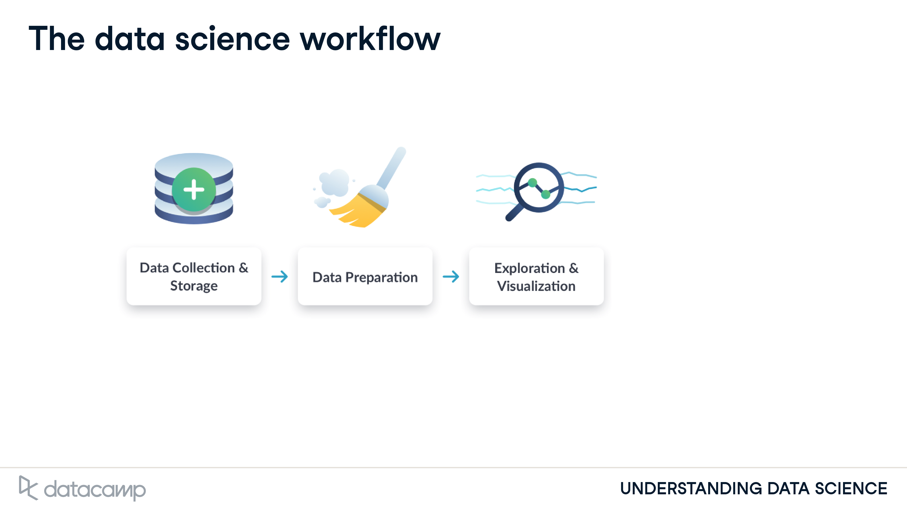
Notes:
Then, we explore and visualize the cleaned data. This could involve building dashboards to track how the data changes over time or performing comparisons between two sets of data.

Slide 14
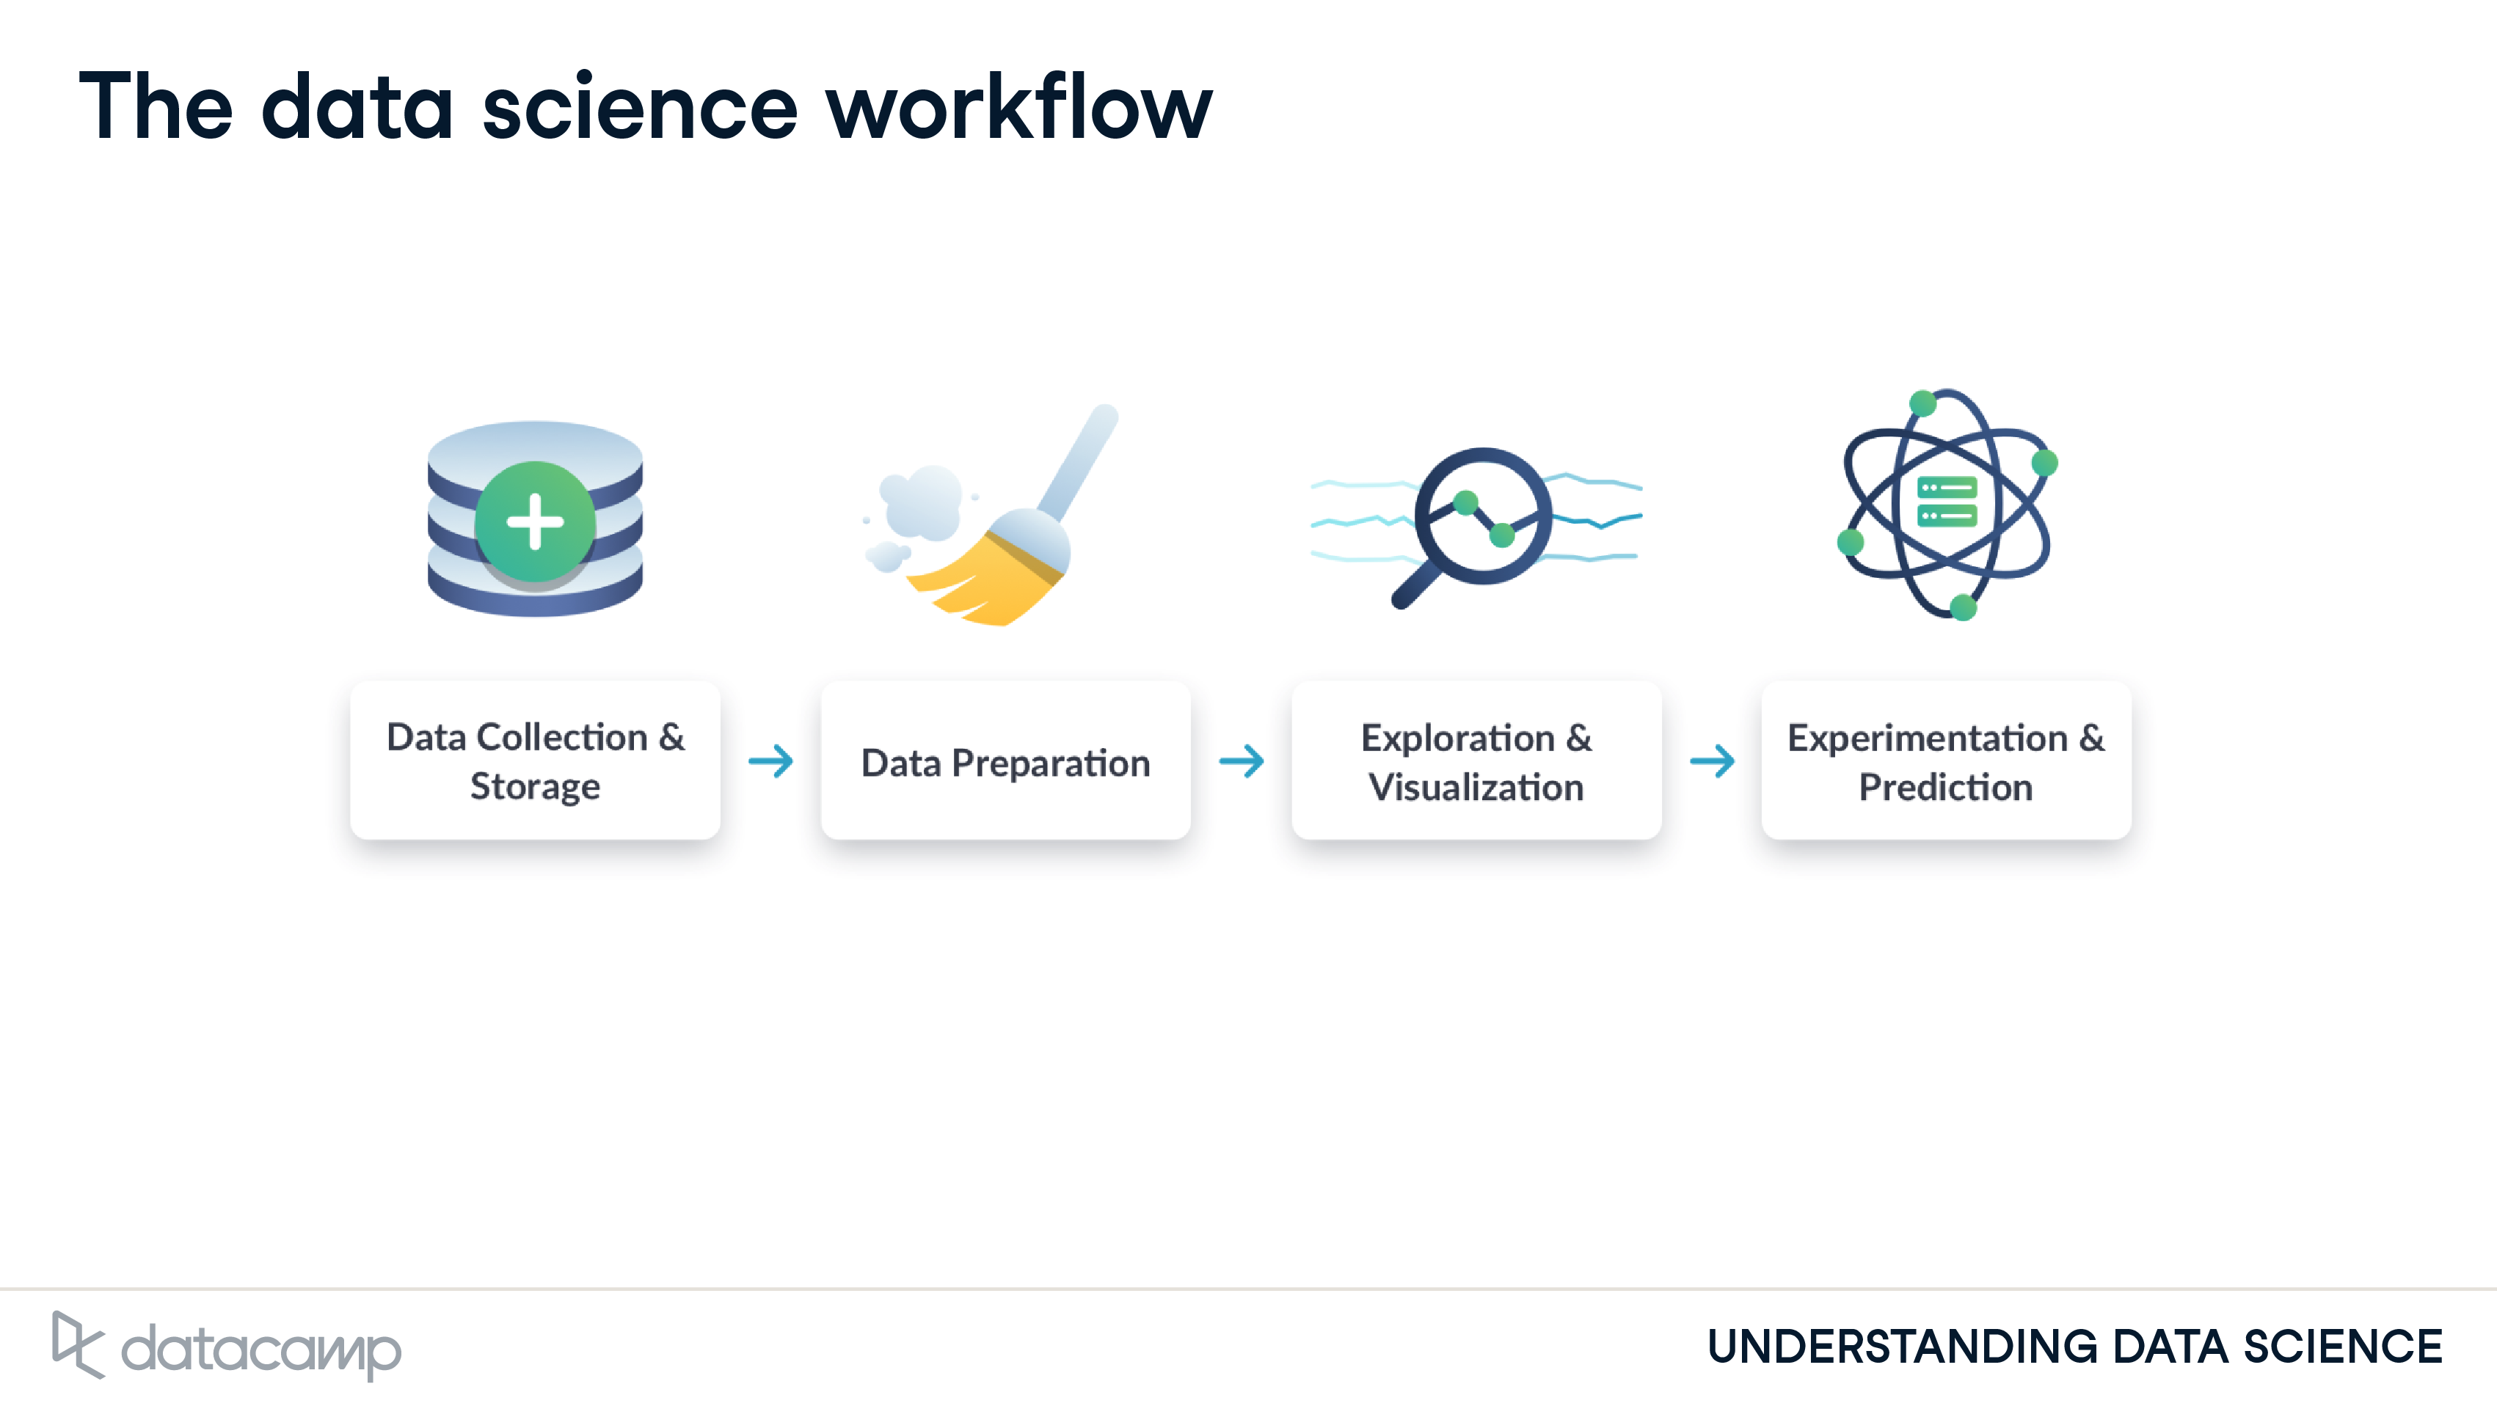
Notes:
Finally, we run experiments and predictions on the data. For example, this could involve building a system that forecasts temperature changes or performing a test to find which web page acquires more customers.

Slide 15
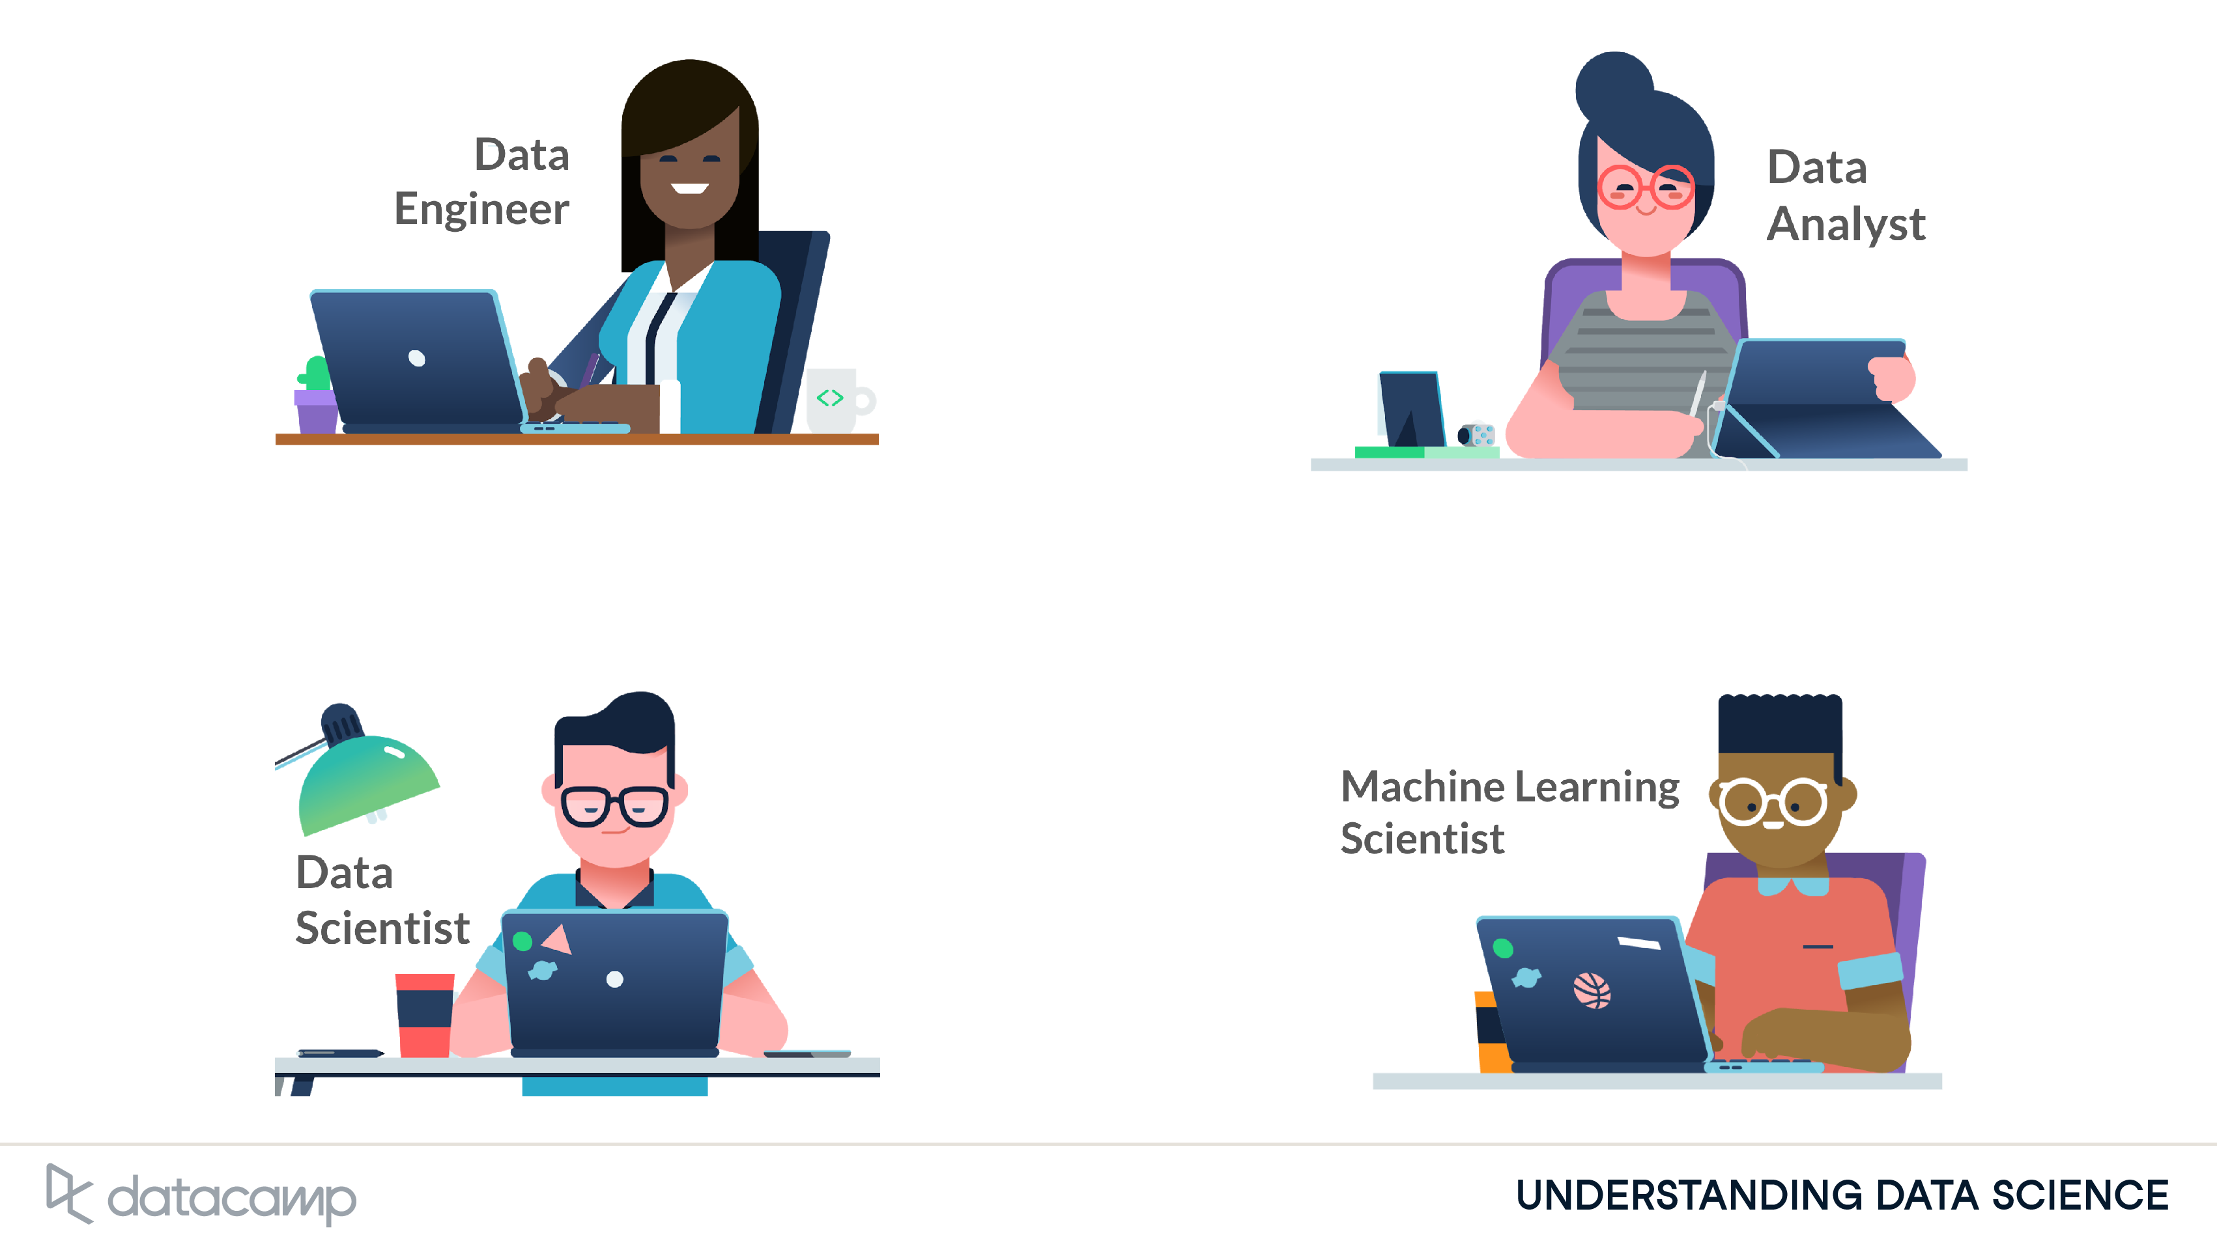
Roles in Data science:
Notes:
You might be surprised to learn that there isn't a single job within data science. Generally, there's four jobs: Data Engineer, Data Analyst, Data Scientist, and Machine Learning Scientist. Let's explore each one.

Slide 16
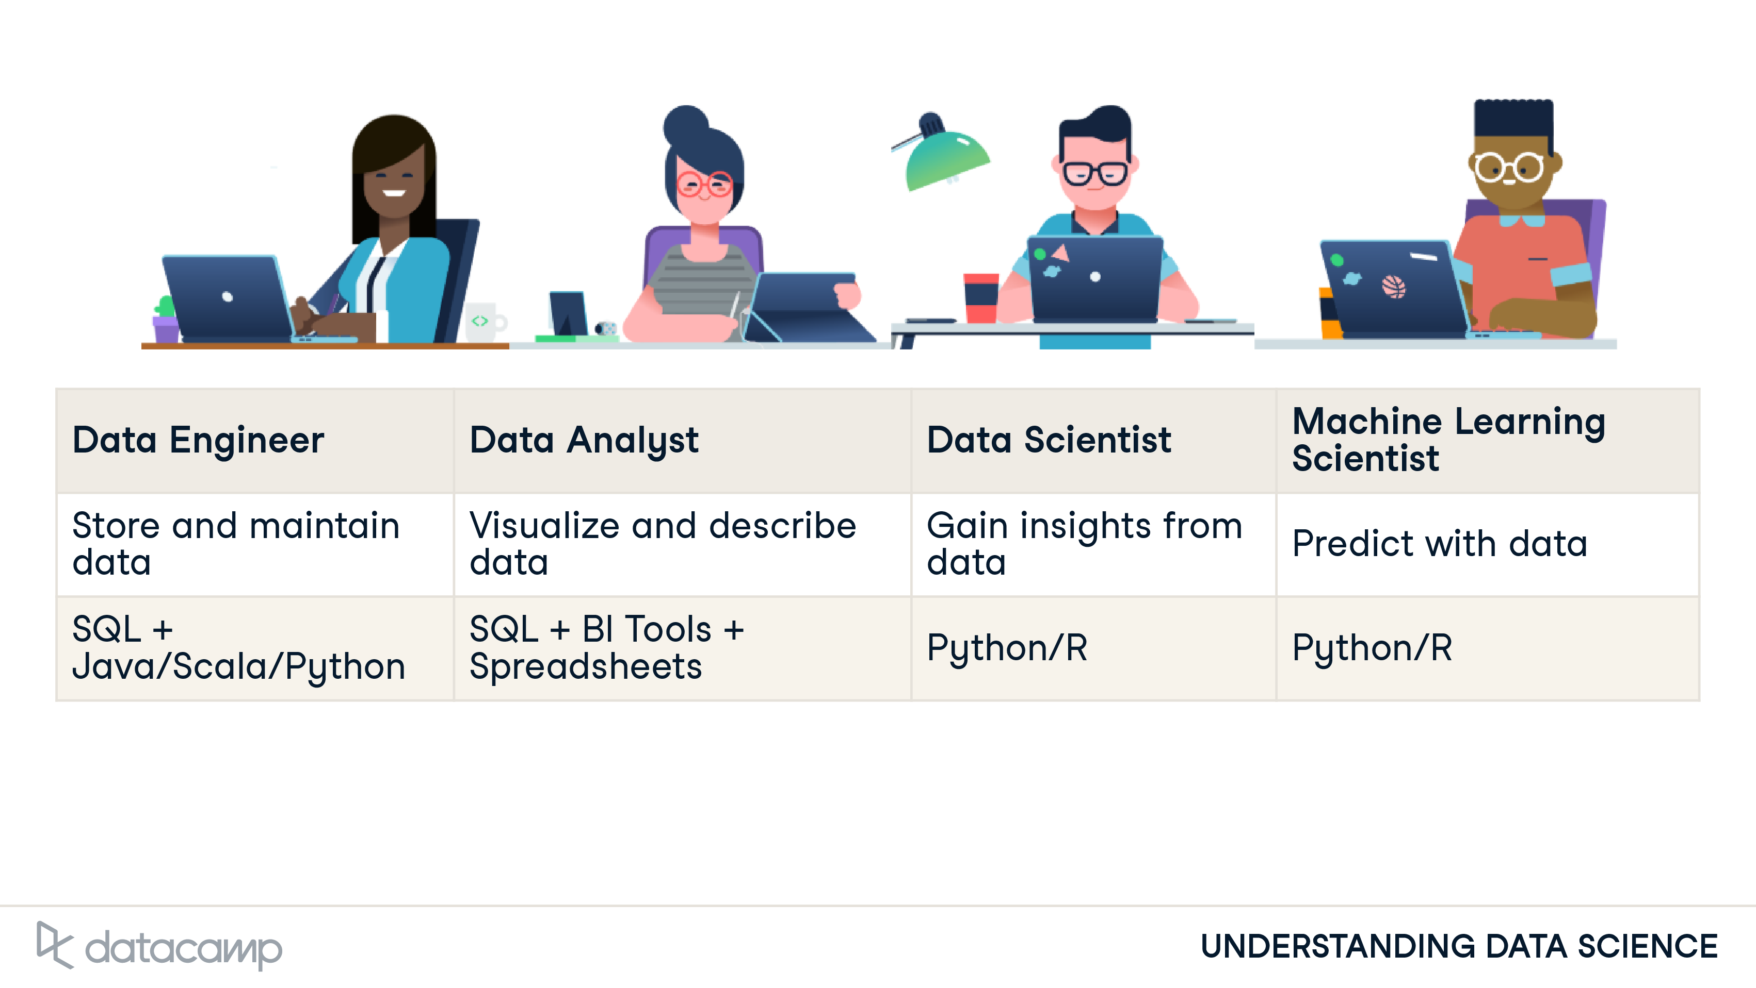
Notes:
Data engineers control the flow of data: they build custom data pipelines and storage systems. They design infrastructure so that data is not only collected, but easy to obtain and process. Within the data science workflow, they focus on the first stage: data collection and storage.
Data analysts describe the present via data. They do this by exploring the data and creating visualizations and dashboards. To do these tasks, they often have to clean data first. Analysts have less programming and stats experience than the other roles. Within the workflow, they focus on the middle two stages: data preparation and exploration and visualization.
Data Scientists have a strong background in statistics, enabling them to find new insights from data, rather than solely describing data. They also use traditional machine learning for prediction and forecasting. Within the workflow, they focus on the last three stages: data preparation and exploration and visualization, and experimentation and prediction.
Machine learning scientists are similar to data scientists, but with a machine learning specialization. Machine learning is perhaps the buzziest part of Data Science; it's used to extrapolate what's likely to be true from what we already know. These scientists use training data to classify larger, unrulier data, whether its to classify images that contain a car, or create a chatbot. They go beyond traditional machine learning with deep learning. Within the workflow, they do the last three stages with a strong focus on prediction.

Slide 17
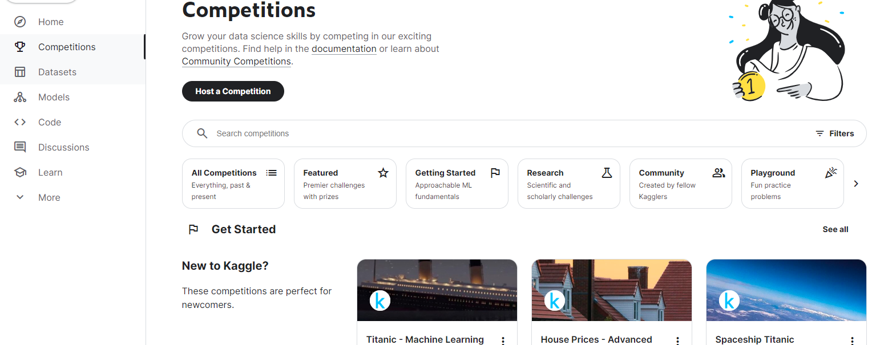
Kaggle

Slide 18
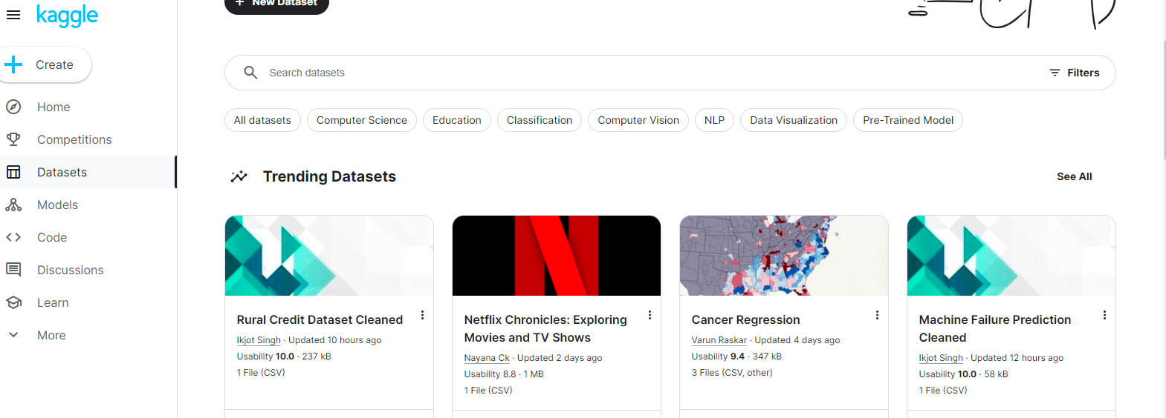

Slide 19
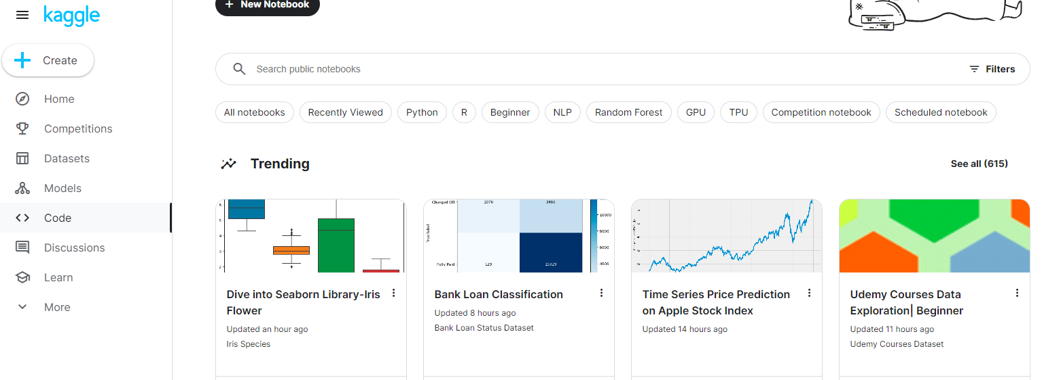

Slide 20
Dataset sources:
UCI:
https://archive.ics.uci.edu/
US Government open datasets:
https://data.gov/
Quandl:
https://alternativedata.org/data_provider/quandl/
World Bank Dataset:
https://data.worldbank.org/
Awesome Public Dataset:
https://github.com/awesomedata/awesome-public-datasets
Notes:
This is a list of topic-centric public data sources in high quality. They are collected and tidied from blogs, answers, and user responses. Most of the data sets listed below are free, however, some are not. This project was incubated at OMNILab, Shanghai Jiao Tong University during Xiaming Chen's Ph.D. studies. OMNILab is now part of the BaiYuLan Open AI community. Other amazingly awesome lists can be found in sindresorhus's awesome list.

Slide 21
Language and Tools:
Python, R
Google Colab
Anaconda
Power BI
Excel
Microsoft Fabric
Databricks
VS code

Slide 22
Some potential projects:
Fraud Detection in Financial transactions
Used in banks to prevent fraud.
MODEL
Transaction amount, location, Frequency
Fraudulant Transactions
Notes:
This project involves building a model to detect fraudulent transactions based on patterns in financial data (e.g., transaction amount, location, frequency). It can help financial institutions prevent fraud.

Slide 23
Recommendation System for E-commerce:
Enhance User experience and increase sales.
MODEL
Past purchases, browsing history, demographic information
Product Recommendations
Notes:
Problem Type: Collaborative filtering, content-based filtering
Possible Tools: Python, scikit-learn, TensorFlow, Keras
Possible Model: Matrix Factorization, Neural Collaborative Filtering, Word Embeddings
Description: The project aims to recommend products to users based on their past purchases, browsing history, and demographic information. It can enhance user experience and increase sales.

Slide 24
HealthCare Predictions:
Predict Disease based on patient data.
MODEL
demographics, medical history, and lifestyle factor
Disease Likelihood(e.g., diabetes, heart disease)
Notes:
Problem Type: Classification or regression
Possible Tools: Python, scikit-learn, TensorFlow, Keras
Possible Model: Logistic Regression, Random Forest, Gradient Boosting, Deep Learning
Description: This project involves predicting the likelihood of disease (e.g., diabetes, heart disease) based on patient data. The model can use features such as demographics, medical history, and lifestyle factors to make predictions.

Slide 25
Some example Insights:
1. Mobile Phone Addiction:
Insight: Recent analysis show that people spend a significant amount of time (over 4.5 hours daily) on their phones, primarily scrolling. This suggests a potential for addiction and the negative impacts it can have on attention spans, productivity, and mental well-being.
2. Changing Communication Patterns:
Insight: The rise of social media and messaging apps has transformed how we communicate. Face-to-face interaction and traditional phone calls are declining, with text-based communication becoming dominant.
3. Online Shopping Boom:
Insight: Data shows a surge in e-commerce, with people increasingly comfortable purchasing online. This trend is fueled by convenience, wider product selection, and competitive pricing.

Slide 26
Any Questions?

